Slide 1

Cloud Native Applications
Advancing Spring Boot with Actuator

Slide 2
Spring Boot Actuator 2
Additional Features to help you monitor and manage your application in production
<dependency>
<groupId>org.springframework.boot</groupId>
<artifactId>spring-boot-starter-actuator</artifactId>
</dependency>

Slide 3
How to enable endpoints
Default exposed endpoints are /info and /health.
management.endpoints.web.exposure.include=*
management.endpoints.web.exposure.include=info,health,env
All endpoints are not secured by default.

Slide 7
Health Indicators
Health Indicator | Performed Checks
DiskSpaceHealthIndicator | Checks for low Disk space
DataSourceHealthIndicator | Check DataSource connection
ElasticsearchHealthIndicator | Checks ElasticSearch cluster is up
JmsHealthIndicator | Checks that a JMS broker is up
MailHealthIndicator | Checks that a mail server is up
MongoHealthIndicator | Cheks that a Mongo database is up
RabbitHealthIndicator | Checks that a Rabbit server is up
RedisHealthIndicator | Checks that a Redis server is up
SolrHealthIndicator | Checks that a Solr server is up
Notes:
Additionally these health indicators, some for backing services, are auto-configured by Spring Boot when appropriate
Information returned by HealthIndicators is often somewhat sensitive in nature. For example, you probably don’t want to publish details of your database server to the world. For this reason, by default, only the health status is exposed over an unauthenticated HTTP connection. If you are happy for complete health information to always be exposed you can set endpoints.health.sensitive to false.
Health responses are also cached to prevent “denial of service” attacks. Use the endpoints.health.time-to-live property if you want to change the default cache period of 1000 milliseconds.

Slide 8
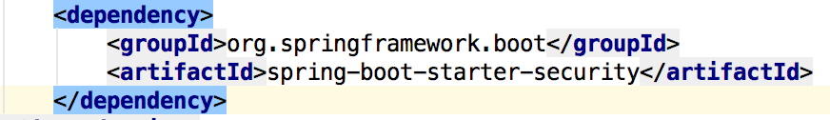
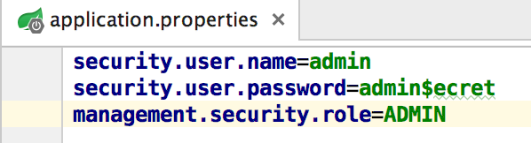
HTTP Access
Importing Spring Security Dependency
Setting required Authentication & Authorization Roles
Notes:
The management endpoints are secure even if the application endpoints are insecure.
Security events are transformed into AuditEvents and published to the AuditService.
The default user will have the ADMIN role as well as the USER role.

Slide 9
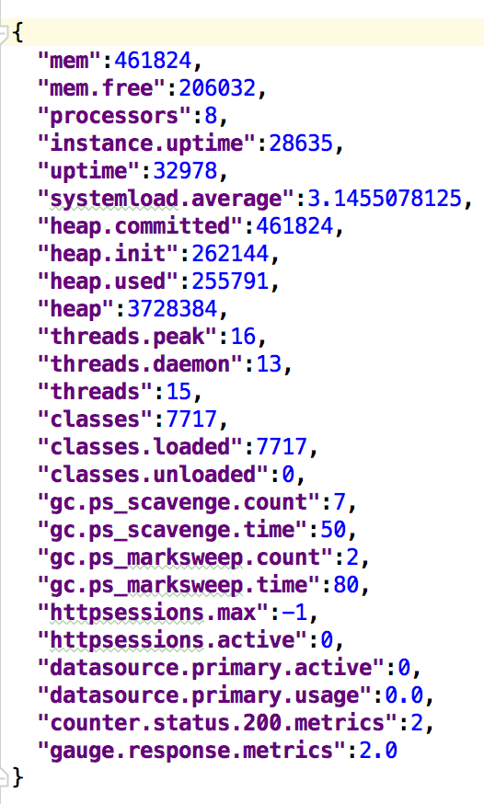
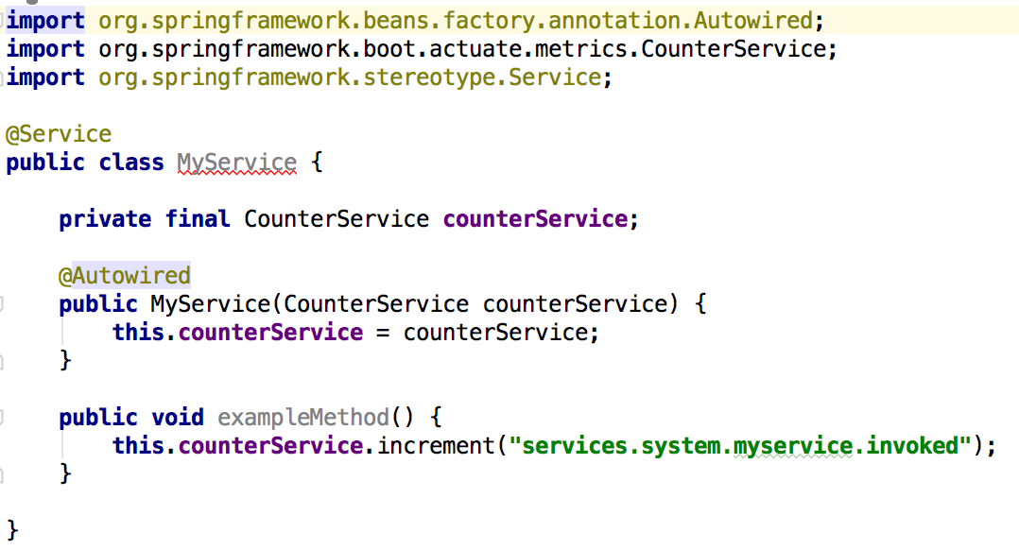
Metrics
Spring Boot Actuator includes a metrics service with ‘gauge’ and ‘counter support
Record your own metrics, inject CounterService and/or GaugeService into your bean
Notes:
A ‘gauge’ records a single value; and a ‘counter’ records a delta (an increment or decrement). Spring Boot Actuator also provides a PublicMetrics interface that you can implement to expose metrics that you cannot record via one of those two mechanisms. Look at SystemPublicMetrics for an example.
Metrics for all HTTP requests are automatically recorded, so if you hit the metrics endpoint you should see a response similar to this:

Slide 10
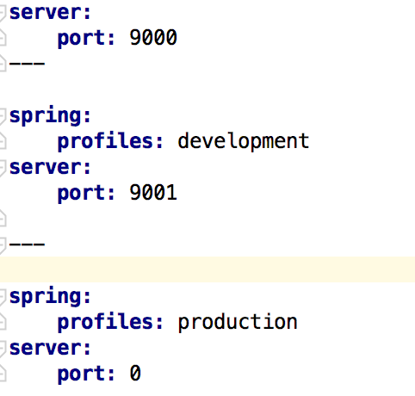


Profiles
YAML file can contain for several documents
Convenient to specify alternate configurations in the same file
Set the active profile
SPRING_PROFILES_ACTIVE=production
or
spring.profiles.active=production
Development profile
Production profile
Notes:
If one wants to set the active Spring profiles
The Spring Environment has an API for this, but normally one would set either a System.property, or an OS environment variable or it can be set in the application.properties (or application.yml) file
The YAML documents are merged in the order they are encountered (so later values override earlier ones)

Slide 11

Lab

